Slide 1
19CSE313 – Principles of Programming Languages
Arrays, Lists and Tuples in Scala

Slide 2
PARAMETERIzation
In Scala, you can instantiate objects, or class instances, using new.
When you instantiate an object in Scala, you can parameterize it with values and types.
Parameterization means "configuring" an instance when you create it.
An instance is parameterized with values by passing objects to a constructor in parentheses.
Example:
val big = new java.math.BigInteger("12345")
Instantiates a
new java.math.BigInteger and parameterizes it with the value "12345"

Slide 3
parameterizing an instance with types
Specify one or more types in square brackets.
Example:
object parray
{
def main(args:Array[String])
{
val greetStrings = new Array[String](3)
greetStrings(0) = "Hello"
greetStrings(1) = ", "
greetStrings(2) = "world!\n"
for (i <- 0 to 2)
print(greetStrings(i))
}
}
D:\PPL\Scala>scalac parray.scala
warning: 1 deprecation (since 2.13.0); re-run with -deprecation for details
1 warning
D:\PPL\Scala>scala parray
Hello, world!
In this example, greetStrings is a value of type Array[String](an "array of string") that is initialized to length 3 by parameterizing it with the value 3 in the first line of code.
Note that when you parameterize an instance with both a type and a value, the type comes first in its square brackets, followed by the value in parentheses.

Slide 4
Explicit parameterization
val greetStrings: Array[String] = new Array[String](3)
Given Scala's type inference, this line of code is semantically equivalent to previous version: val greetStrings = new Array[String](3)
But this form demonstrates that while the type parameterization portion (the type names in square brackets) forms part of the type of the instance, the value parameterization part (the values in parentheses) does not.
The type of greetStrings isArray[String], not Array[String](3).

Slide 5
initializing each element of the array
greetStrings(0) = "Hello"
greetStrings(1) = ", "
greetStrings(2) = "world!\n“
Arrays in Scala are accessed by placing the index inside parentheses, not square brackets as in Java.
Thus the zeroth element of the array isgreetStrings(0), not greetStrings[0].

Slide 6
Meaning of val explained…
val greetStrings = new Array[String](3)
When a variable with is defined as val, the variable can't be reassigned, but the object to which it refers could potentially still be changed.
In this case, greetStrings cannot be reassigned to a different array; greetStrings will always point to the same Array[String] instance with which it was initialized.
But the elements of the Array[String] can be changed over time, hence the array itself is mutable.

Slide 7
The To method
for (i <- 0 to 2)
print(greetStrings(i))
If a method takes only one parameter, you can call it without a dot or parentheses.
The to in this example is actually a method that takes one Int argument.
The code 0 to 2 is transformed into the method call (0).to(2).
Note that this syntax only works if you explicitly specify the receiver of the method call.
You cannot write "println 10", but you can write "Console println 10".

Slide 8
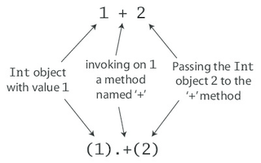
Operator overloading
Technically Scala doesn't have operator overloading, because it doesn't actually have operators in the traditional sense.
Characters such as +, -, *, and / can be used in method names.
Hence, when 1 + 2 is typed into the Scala interpreter in Step 1, a method named + is actually invoked on the Int object 1, passing in 2 as a parameter.
Alternatively one could write 1 + 2 using traditional method invocation syntax, (1)+(2)
All operations are method calls in Scala

Slide 9
Arrays are classes in scala
Arrays are accessed with parentheses in Scala.
Arrays are simply instances of classes like any other class in Scala.
Scala has fewer special cases than Java.
When parentheses is applied surrounding one or more values to a variable, Scala will transform the code into an invocation of a method named apply on that variable.
For e.g., greetStrings(i) gets transformed into greetStrings.apply(i).
Thus accessing an element of an array in Scala is simply a method call like any other.
This principle is not restricted to arrays: any application of an object to some arguments in parentheses will be transformed to an apply method call.
Of course this will compile only if that type of object actually defines an apply method.
So it's not a special case; it's a general rule.

Slide 10
Update method
When an assignment is made to a variable to which parentheses and one or more arguments have been applied, the compiler will transform that into an invocation of an update method that takes the arguments in parentheses as well as the object to the right of the equals sign.
For example:
greetStrings(0) = "Hello“ greetStrings.update(0, "Hello")
Transformed to
val greetStrings = new Array[String](3)
greetStrings(0) = "Hello"
greetStrings(1) = ", "
greetStrings(2) = "world!\n"
for (i <- 0 to 2)
print(greetStrings(i))
val greetStrings = new Array[String](3)
greetStrings.update(0, "Hello")
greetStrings.update(1, ", ")
greetStrings.update(2, "world!\n")
for (i <- 0.to(2))
print(greetStrings.apply(i))
Equivalent

Slide 11
Scala objects
Scala achieves conceptual simplicity by treating everything, from arrays to expressions, as objects with methods.
There is no need to remember special cases, such as the differences in Java between primitive and their corresponding wrapper types, or between arrays and regular objects.
Moreover, this uniformity does not incur a significant performance cost.
The Scala compiler uses Java arrays, primitive types, and native arithmetic where possible in the compiled code.

Slide 12
a more concise way to create and initialize arrays in scala
val numNames = Array("zero", "one", "two")
This is calling a factory method, named apply, which creates and returns the new array.
This apply method takes a variable number of arguments and is defined on the Array companion object
A more verbose way to call the same apply method is:
val numNames2 = Array.apply("zero", "one", "two")

Slide 13
Using lists in scala
List Creation:
val oneTwoThree = List(1, 2, 3)
List Concatenation using ::: method:
val oneTwo = List(1, 2)
val threeFour = List(3, 4)
val oneTwoThreeFour = oneTwo ::: threeFour
println(oneTwo + " and " + threeFour + " were not mutated.")
println("Thus, " + oneTwoThreeFour + " is a new list.")
List(1, 2) and List(3, 4) were not mutated.
Thus, List(1, 2, 3, 4) is a new list.

Slide 14
Cons operator in scala
Prepends a new element to the beginning of an existing list and returns the resulting list
Example:
val twoThree = List(2, 3)
val oneTwoThree = 1 :: twoThree
println(oneTwoThree)
List(1, 2, 3)

Slide 15
Initialising new lists with cons operator and Nil
Empty list is represented as Nil
Example:
val oneTwoThree = 1 :: 2 :: 3 :: Nil
println(oneTwoThree)
The above script will produce the same output as List(1, 2, 3)

Slide 16
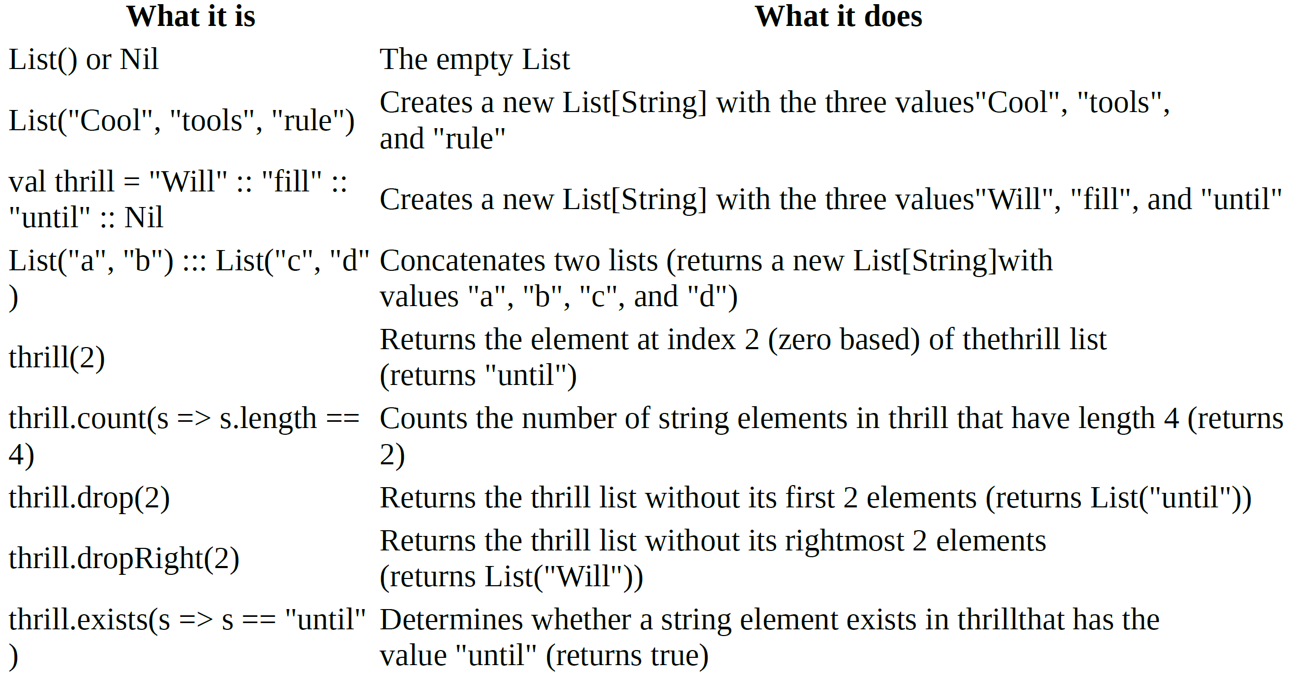
Some list methods and their usages

Slide 17
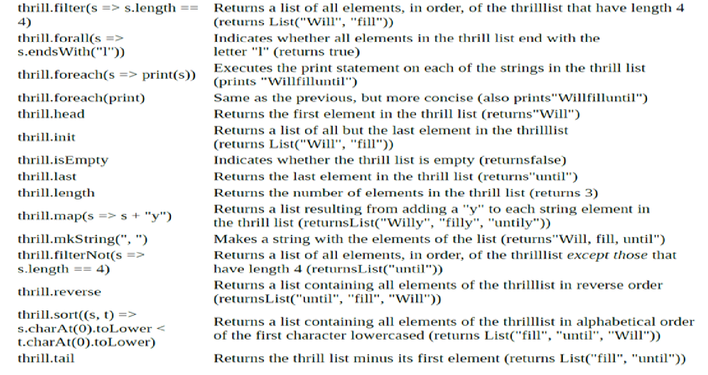
Some list methods and their usages

Slide 18
tuples
Like lists, tuples are immutable, but unlike lists, tuples can contain different types of elements.
Whereas a list might be a List[Int] or a List[String], a tuple could contain both an integer and a string at the same time.
val pair = (99, "Luftballons")
println(pair._1)
println(pair._2)
99
Luftballons
To instantiate a new tuple that holds some objects, just place the objects in parentheses, separated by commas.
Once you have a tuple instantiated, you can access its elements individually with a dot, underscore, and the one-based index of the element.

Slide 19
tuples
The actual type of a tuple depends on the number of elements it contains and the types of those elements.
Thus, the type of (99, "Luftballons") is Tuple2[Int, String].
The type of ('u', 'r', "the", 1, 4, "me") is Tuple6[Char, Char, String, Int, Int, String].
ACCESSING THE ELEMENTS OF A TUPLE
The elements of a tuple cannot be accessed like the elements of a list, for example, with "pair(0)".
Since list's apply method always returns the same type, but each element of a tuple may be a different type: _1 can have one result type, _2 another, and so on.
These _N numbers are one-based, instead of zero-based, because starting with 1 is a tradition set by other languages with statically typed tuples, such as Haskell and ML.

Slide 20
Array creation and Access – Example
import Array._
object arraydemo
{
val myarr1:Array[Int] = new Array[Int](4); //Creation method 1
val myarr2 = new Array[String](5); //Creation method 2
val myarr3 = Array(1.5,2.3,6.4); //Creation method 3
val myarr4 = Array(1,2,3,4);
def main(args:Array[String])
{
myarr1(0)=20; //Assignments
myarr1(1)=50;
myarr1(2)=10;
myarr1(3)=30;
for(i<-myarr1) //Access Method 1
{
println(i);
}
for(i<- 0 to (myarr1.length-1)) //Access Method 2
{
println(myarr1(i));
}
for(i<-myarr2) //Prints default value if unassigned
{
println(i);
}
println(myarr3.length); //no of elements
val join = concat(myarr1,myarr4); //concatenates same array type
for(i<-join)
{
println(i);
}
}
}

Slide 21
Array creation and access – example Output
D:\PPL\Scala>scala arraydemo
20
50
10
30
20
50
10
30
null
null
null
null
null
3
20
50
10
30
1
2
3
4

Slide 22
List creation and processing
object listdemo
{
val mylist1:List[Int] = List(1,2,3,4);
val mylist2:List[String]=List("John", "Tim", "Ken");
def main(args:Array[String])
{
println(mylist1);
println(mylist2);
//mylist1(0)=50; //List is immutable - cant change
//println(mylist1);
println(50::mylist1); //cons :: to prepend
println(mylist1); //value does'nt change by ::
println(1::3::5::Nil); //creates and prints a list
println(mylist2.head); //to print first item
println(mylist2.tail); //prints last item
println(mylist2.isEmpty); //checks if list is empty
println(mylist1.reverse); //prints list in reverse
println(List.fill(5)(2)); //creates a list of 5 2's
println(mylist1.max); //prints max item in list
mylist2.foreach(println); //iterates thru each elt
var sum:Int=0; //sum of list using foreach
mylist1.foreach(sum += _);
println(sum);
for(i<-mylist2) //iteration using for
{
println(i);
}
println(mylist2(1)); //list indexing
}
}

Slide 23
List creation and processing - output
D:\PPL\Scala>scala listdemo
List(1, 2, 3, 4)
List(John, Tim, Ken)
List(50, 1, 2, 3, 4)
List(1, 2, 3, 4)
List(1, 3, 5)
John
List(Tim, Ken)
false
List(4, 3, 2, 1)
List(2, 2, 2, 2, 2)
4
John
Tim
Ken
10
John
Tim
Ken
Tim

Slide 24
Tuple Creation and access - example
object tupdemo
{
val mytuple1 = (1,2,"hi",false);
val mytuple2 = new Tuple4 (3,4,"hello",true); //no of items to be specified - allowed upto 22 elements
val mytuple3 = new Tuple3 (5,"welcome",(1,2)); //Tuple in tuple
def main(args:Array[String])
{
println(mytuple1);
println(mytuple2._3); //Tuples indexed from 1
println(mytuple3._3); //To print nested tuple
println(mytuple3._3._2); //To print nested tuple element
mytuple1.productIterator.foreach //iterating thru a tuple
{
i => println(i);
}
}
}

Slide 25
Tuple Creation and access - Output
D:\PPL\Scala>scala tupdemo
(1,2,hi,false)
hello
(1,2)
2
1
2
hi
false

Slide 26
Thank you

